Slide 1

Dollars & Data: Analyzing US Household Income with MySQL
Created by: Syed Daniyal Ahmed
Business Intelligence & Data Analyst

Slide 2
Introduction:
Household income is one of the most important indicators of economic well-being in the United States.
It directly impacts living standards, access to healthcare, education, housing affordability, and social mobility.
In recent decades, trends in household income have been influenced by inflation, wage stagnation, globalization, technological change, and demographic shifts.
Understanding income distribution patterns helps policymakers, researchers, and businesses design better economic strategies and social programs.
Created by: Syed Daniyal Ahmed
Business Intelligence & Data Analyst

Slide 3
Project Overview:
The project focuses on analyzing U.S. household income data to uncover patterns, disparities, and long-term trends.
Data sources may include U.S. Census Bureau (Current Population Survey, American Community Survey), Bureau of Labor Statistics, and Federal Reserve reports.
The analysis covers aspects such as:
Median household income (national, regional, state-level)
Income inequality (Gini coefficient, top vs. bottom percentiles)
Demographic breakdowns (race, gender, age, education, employment sector)
Cost of living vs. income growth
The ultimate goal is to provide data-driven insights into how income is distributed and what factors drive disparities.
Created by: Syed Daniyal Ahmed
Business Intelligence & Data Analyst

Slide 4
Problem Statement:
Despite being one of the wealthiest nations, the U.S. faces growing income inequality and stagnant wages for middle- and lower-income households.
Median household income growth has not kept pace with inflation, reducing real purchasing power.
Wealth is increasingly concentrated in the top income brackets, while many households struggle with basic affordability (housing, healthcare, education).
Disparities in income are highly correlated with race, education, and geographic region, reflecting deep-rooted structural inequalities.
Without accurate data analysis, policies may fail to address the real challenges of income disparity, leaving vulnerable populations behind.
Created by: Syed Daniyal Ahmed
Business Intelligence & Data Analyst

Slide 5
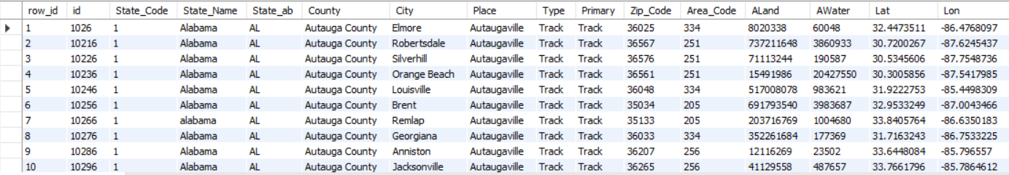
Unstructured Data:
Created by: Syed Daniyal Ahmed
Business Intelligence & Data Analyst

Slide 6
Summary of Problems:
Duplicate/confusing columns (row_id vs id, Type vs Primary).
Ambiguous names (Place, Type, Primary, Area_Code).
Inconsistent naming conventions (snake_case + PascalCase mix).
Abbreviations that aren’t self-explanatory (ALand, AWater, Lat, Lon).
Case-sensitivity inconsistency in values (Alabama vs alabama).
Created by: Syed Daniyal Ahmed
Business Intelligence & Data Analyst

Slide 7
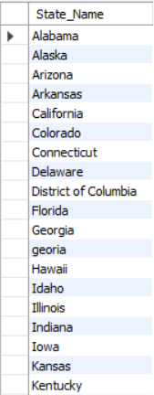
Q1: Show me all the unique state names from the table us_household_income.
Created by: Syed Daniyal Ahmed
Business Intelligence & Data Analyst

Slide 8
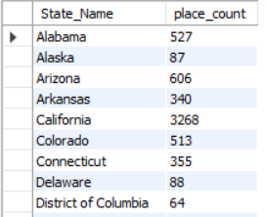
Q2: Write a SQL query to display each state name along with the count of rows (places/records) for that state in the us_household_income table.
Created by: Syed Daniyal Ahmed
Business Intelligence & Data Analyst

Slide 9
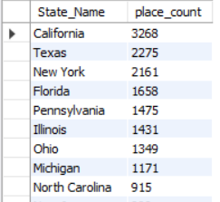
Q3: Write a SQL query to list all states along with the number of places they contain, and display them in descending order of place count.
Created by: Syed Daniyal Ahmed
Business Intelligence & Data Analyst

Slide 10
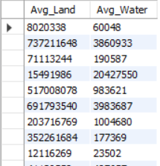
Q4: Write a SQL query to display the Avg_Land and Avg_Water values from the us_household_income table.
Created by: Syed Daniyal Ahmed
Business Intelligence & Data Analyst

Slide 11
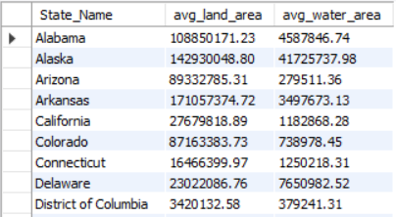
Q5: Write a SQL query to calculate the average land area and average water area for each state in the us_household_income table, rounded to two decimal places.
Created by: Syed Daniyal Ahmed
Business Intelligence & Data Analyst

Slide 12
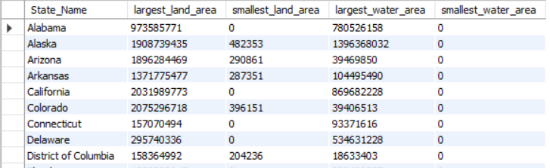
Q6: Write a SQL query to display, for each state, the largest and smallest land area values and the largest and smallest water area values from the us_household_income table.
Created by: Syed Daniyal Ahmed
Business Intelligence & Data Analyst

Slide 13
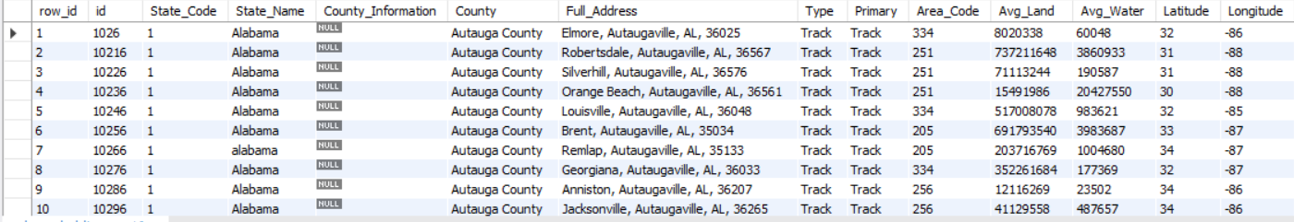
Structured Data:
Created by: Syed Daniyal Ahmed
Business Intelligence & Data Analyst

Slide 14
Summary of Structured Data:
1. row_id ek surrogate key hai jo har row ko uniquely identify karta hai. 2. id dataset ka actual unique identifier hai jo source se aaya hai. 3. State_Code ek numeric code hai jo state ko represent karta hai. 4. State_Name me state ka naam hai lekin casing inconsistent hai (Alabama vs alabama). 5. County_Information mostly NULL hai aur redundant lag raha hai. 6. County county ka naam store karta hai. 7. Full_Address composite field hai jisme city, county, state aur zip combine hain. 8. Type aur Primary dono hi "Track" repeat kar rahe hain aur extra lag rahe hain. 9. Area_Code census ka geographic area code hai, phone code nahi. 10. Avg_Land land area value hai, lekin naam misleading hai (better hota Land_Area). 11. Avg_Water water area value hai, iska bhi naam misleading hai (better hota Water_Area). 12. Latitude aur Longitude coordinates hain mapping aur GIS analysis ke liye.
Created by: Syed Daniyal Ahmed
Business Intelligence & Data Analyst

Slide 15
Final Takeaways:
Household income isn’t just numbers, it’s quality of life. Income trends directly shape affordability, opportunity, and long-term economic security.
Inequality is widening. Wealth is concentrating at the top, while middle- and lower-income households face wage stagnation and rising costs of living.
Demographics matter. Race, education, gender, and geography all play a huge role in shaping income outcomes, reflecting systemic imbalances.
Real vs. nominal income. Even when incomes rise on paper, inflation often erodes actual purchasing power.
Data is power. Careful analysis of household income data helps identify structural issues, forecast trends, and guide evidence-based policymaking.
Future focus: Without addressing disparities, income inequality could threaten social mobility, economic stability, and trust in institutions.
Created by: Syed Daniyal Ahmed
Business Intelligence & Data Analyst

